Slide 2
Outline
ABSTRACT
PROBLEM STATEMENT
OBJECTIVES
EXPECTED OUTCOME
LITERATURE REVIEW
DESIGN CONSIDERATIONS
DESIGN CALCULATIONS
INITIAL DESIGNS
REDESIGNS
FABRICATION
RESULTS AND DISCUSSION
CONCLUSION AND RECOMMENDATIONS
[http://www.iea.org/]
[http://www.effectofglobalwarming.com/]

Slide 3
Abstract
Poultry farming constitutes a lot of tasks that can be broken down into feeding, watering ,egg collection and waste management, which require a large amount of time and labor
The proposed design integrated mechanical, electrical and control systems so as to automate these tasks.
The solution attained was able to automate all these systems and consequently reduce amount of time and labor required to rear chicken.
Notes:
Talk of how waste is cleaned and feed supplied.
As stated earlier ,
What will automating do for you?

Slide 4
Problem Statement
In Kenya, a lot of manual work is required in the rearing of poultry birds. By automating certain processes involved in poultry farming will subsequently reduce the amount of time and labor required to rear poultry hens. This thus creates a need to have an efficiently automated chicken housing units that will make rearing of poultry easier.
Notes:
Talk of how waste is cleaned and feed supplied.
As stated earlier ,
What will automating do for you?

Slide 5
Objectives
Main Objective
To design and fabricate an automated chicken coop system.
Specific Objectives
To design a system that monitors the amount of feed and water available for the chickens.
To design a system that counts and collects at some point the eggs laid.
To design a system that allows for remote access of the chicken coop.
To design a system that manages waste removal from the chicken coop.
Notes:
8/10/2018
4
Feed and water.
Remote
Waste
Egg collection

Slide 6
Expected Outcomes
The design solution was expected to perform the following functions:
Automate the feeding, watering and lighting systems.
Count the eggs laid and collect them in one area.
Ensure the coop remain in clean hygienic conditions
Enable remote access of the coop.
Notes:
8/10/2018
5
Feed and water.
Remote
Waste
Egg collection

Slide 7
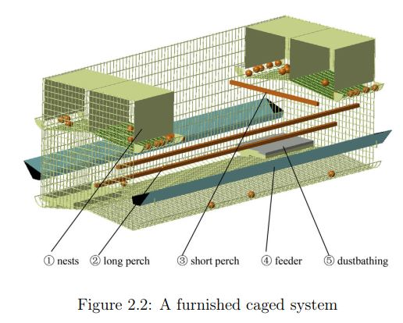
Literature Review
Some of the currently existing systems include:
Its gap analysis:
It is a mechanical system that still requires a sufficient amount of time and labor.
Notes:
8/10/2018
6
Feed and water.
Remote
Waste
Egg collection

Slide 8
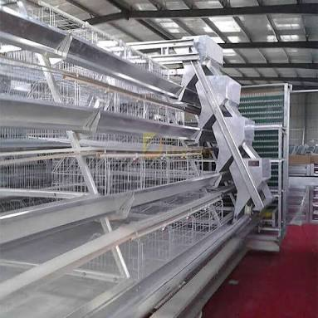
Literature Review
Some of the currently existing systems include:
Its gap analysis:
It is expensive
Automated Chicken Coop
Notes:
8/10/2018
7
Feed and water.
Remote
Waste
Egg collection

Slide 9
Design Considerations
Sub system | Design Considerations
Caging Structure | Space and ventilation. Structural strength. Aesthetic Value.
Feeding Subsystem | Material and size. Amount of feed transmitted. Feed transmission system. Feed storage system.
Waste Management Subsystem | Simplicity and effectiveness. Cost. Material.
Notes:
8/10/2018
8
Feed and water.
Remote
Waste
Egg collection

Slide 10
Design Considerations
Sub system | Design Considerations
Watering Subsystem | Amount of water to hold. Resistance to corrosion. Accessibility.
Lighting Subsystem | Cost and availability. Energy consumption. Lifespan.
Egg Collection Subsystem | Material and size. Size of the egg. Mechanical strength
Notes:
8/10/2018
9
Feed and water.
Remote
Waste
Egg collection

Slide 11
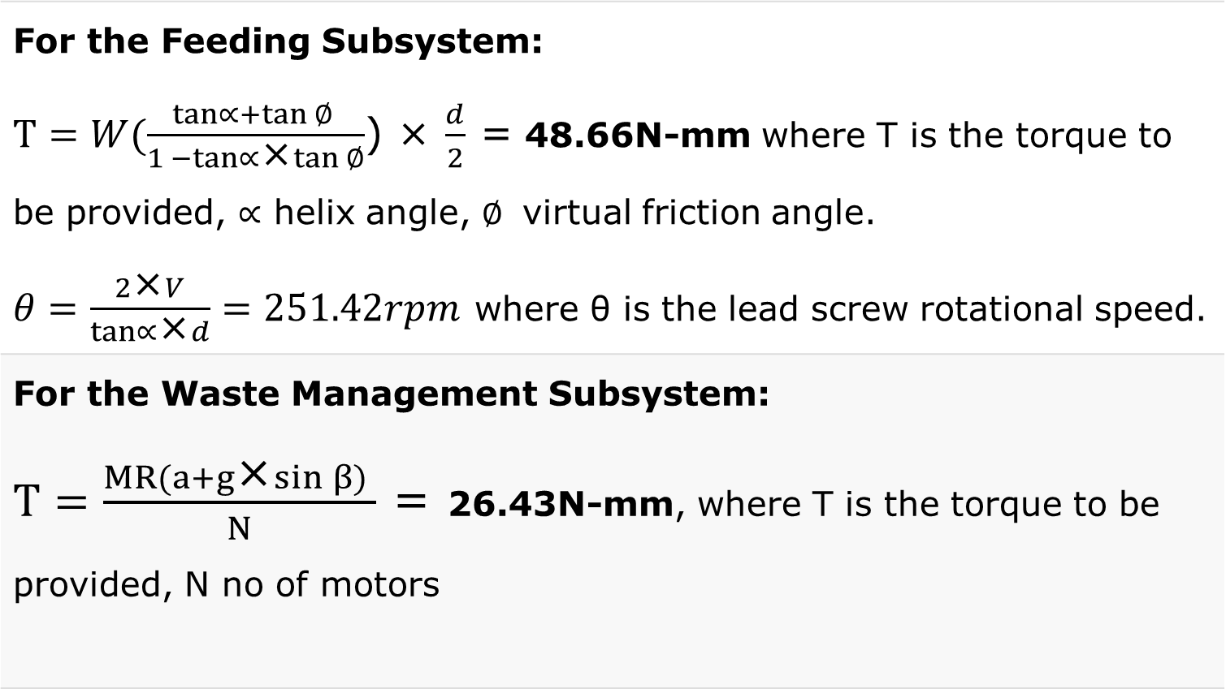
Design Calculations
For the Feeding Subsystem: $T=W(\frac{\tan{∝}+\tan{∅ }}{1 −\tan{∝\text{×}tan{∅}}}$) × $\frac{d}{2}$ = 48.66N-mm where T is the torque to be provided, $∝$ helix angle, $∅$ virtual friction angle. $θ=\frac{2\text{×}V}{\tan{∝\text{×}d}}=251.42rpm$ where θ is the lead screw rotational speed.
For the Waste Management Subsystem: $T=\frac{MR(a+g\text{×}sin β) }{N}$ = 26.43N-mm, where T is the torque to be provided, N no of motors
Notes:
8/10/2018
10
Feed and water.
Remote
Waste
Egg collection

Slide 12
Initial Project Designs
[http://www.iea.org/]
[http://www.effectofglobalwarming.com/]
Notes:
A minimumfloor space = 1200 cm^2 per hen. Ours provides 11,250

Slide 13
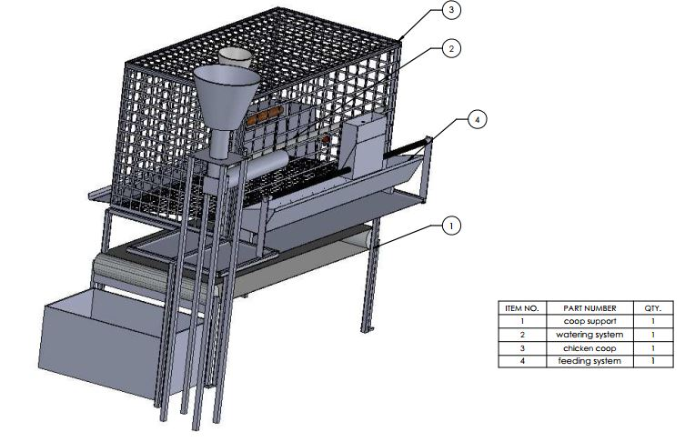
Initial Project Designs
[http://www.iea.org/]
[http://www.effectofglobalwarming.com/]
Notes:
A minimumfloor space = 1200 cm^2 per hen. Ours provides 11,250

Slide 14
Redesigns
Full Mechanical design
Justification:
To accommodate the 1000mm lead screw

Slide 15
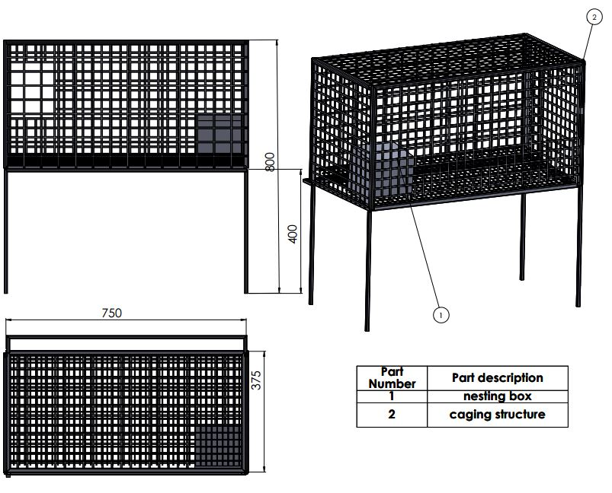
Redesigns
Caging System
Materials used:
0.5 mm square steel tubes
Mild steel
3×3 welded low carbon steel mesh
Justification:
To save on materials used
[http://www.effectofglobalwarming.com/]
Notes:
A minimumfloor space = 1200 cm^2 per hen. Ours provides 11,250

Slide 16
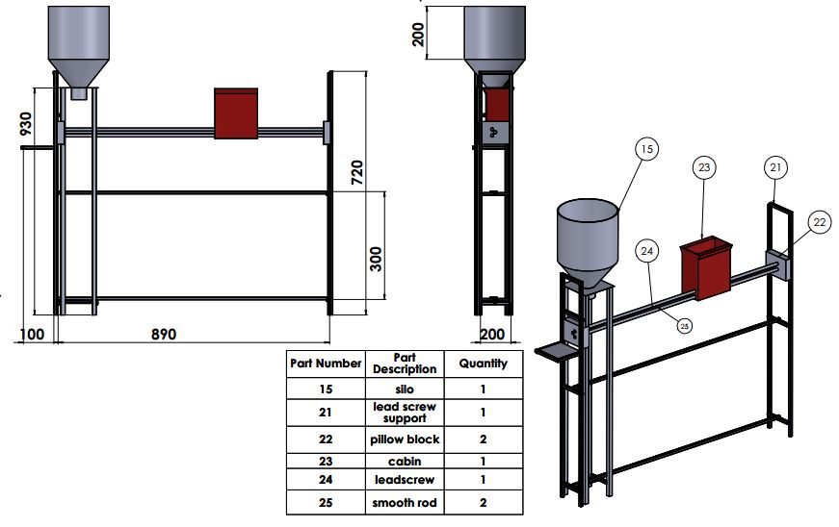
Redesigns
Feeding System
Materials used:
0.5 mm square steel tubes
Mild steel
Aluminium
PLA plastic
Justification:
To improve on the structural integrity of the system
[http://www.iea.org/]
[http://www.effectofglobalwarming.com/]
Notes:
A minimumfloor space = 1200 cm^2 per hen. Ours provides 11,250

Slide 17
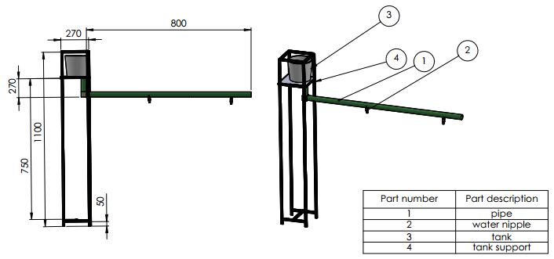
Redesigns
Watering System
Materials used:
Mild steel
PVC pipe
Water nipple
Plastic tank
[http://www.iea.org/]
Justification:
To improve on the structural integrity of the subsystem
[http://www.effectofglobalwarming.com/]
Notes:
A minimumfloor space = 1200 cm^2 per hen. Ours provides 11,250

Slide 18
Redesign
Full Mechanical design

Slide 19
Fabrication: Project Flow
Purchase of the materials.
Construction of the coop frame
Construction of the feeding trough
Construction of the leadscrew support structure
Construction of the silo system
Construction of the water tank system.
Fabrication of the Electrical system
Assembly of the system.
Design of the electrical circuit.
Testing and Optimization.
Presentation.
Construction of the Egg Collection System
Construction of the waste management system

Slide 20
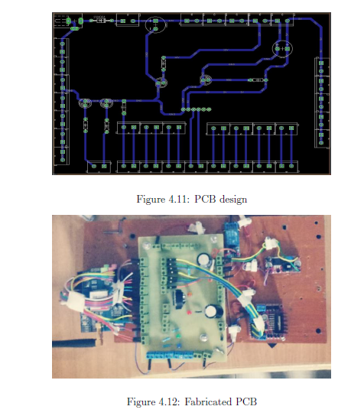
Fabrication: Electrical module
PCB Design
Fabricated PCB

Slide 21
Fabrication: Mechanical module

Slide 22
Fabrication: Mechanical module
Feeding system
Side view

Slide 23
Results and Discussion
Comparison between the Expected Outcomes and the Results
Expected Outcomes | Results
Automate the feeding, watering and lighting systems. | The feeding, watering and lighting systems were automated.
Enable remote access of the coop. | The coop was accessible remotely via SMS.
Ensure the coop remain in clean hygienic conditions | The waste in the coop was cleaned autonomously.
Count the eggs laid and collect them in one area. | Eggs were collected at a common point. Sensor generated false positives.
Notes:
8/10/2018
22
Feed and water.
Remote
Waste
Egg collection

Slide 24
Results and Discussion
The main challenges we faced were:
One of the shafts of the driving roller broke after fabrication.
A low speed-high torque motor that was available in school was used for moving cabin.
The egg collection sensor was too sensitive and thus generated false positives when tested.
Small pitch of the lead screw, made motion slow.
Breakdown of school 3D printer; external services forced over budget.
Notes:
8/10/2018
23
Feed and water.
Remote
Waste
Egg collection

Slide 25
Conclusion
By the integration of all of the discussed designs, the solution that was created reduced the amount of work and time required to rear chicken. The design and fabrication of the automated chicken coop was successfully completed and it was able to achieve most of its objectives.
Notes:
Talk of how waste is cleaned and feed supplied.
As stated earlier ,
What will automating do for you?

Slide 26
Recommendations
Purchase pillow blocks instead of fabricating.
Bench pressing the mesh before welding it onto the floor of the coop to ensure it is completely flat.
Using a lead screw of a large pitch.
Carrying out the proper lab test to ensure accurate dimensioning of the silo.
The sharp IR sensor for counting eggs is not recommended for the function of counting eggs. A break beam IR sensor was thought as a possible replacement for it.
Notes:
Talk of how waste is cleaned and feed supplied.
As stated earlier ,
What will automating do for you?

Slide 27
Commercial viability
Cost based retail pricing:
Cost Of Goods Sold × 3= retail price
Assuming C.O.G.S =30,000+15000(for labour)=45,000
Retail price= 135,000/=

Slide 28


T
H
A
N
K
Y
O
U
!

